Slide 1
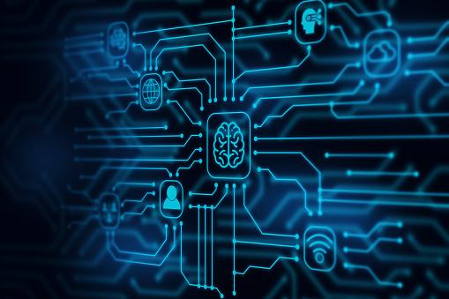
TEAM JPW
AI Case Study
Jack
Peter Seo
z5251261
z5267344
William
z5286124

Slide 2
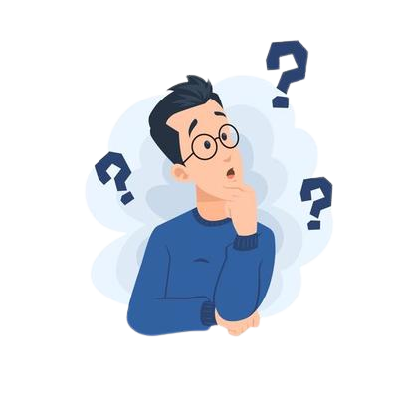

Slide 3
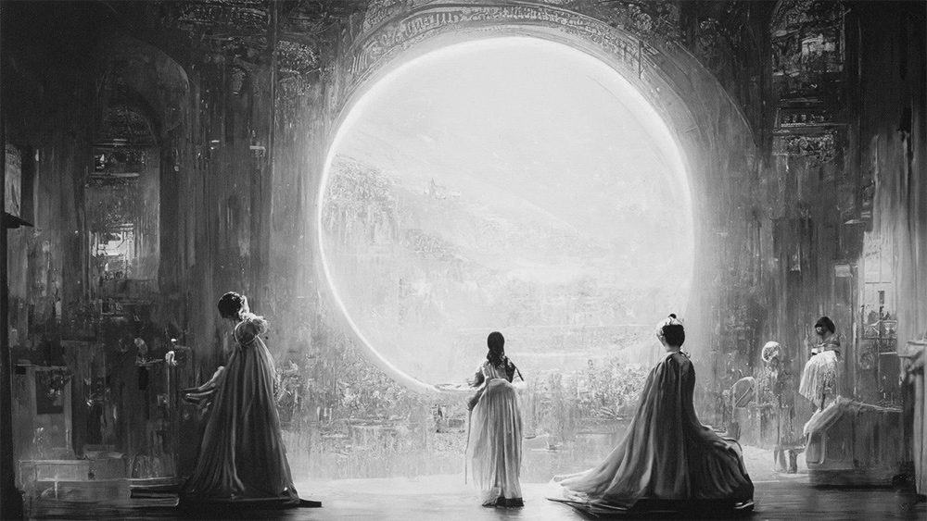
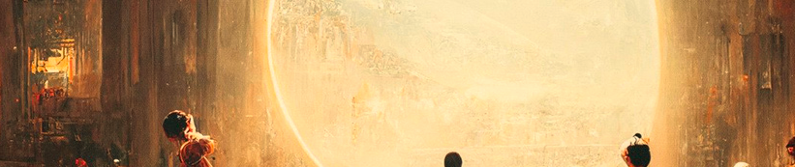

Slide 4
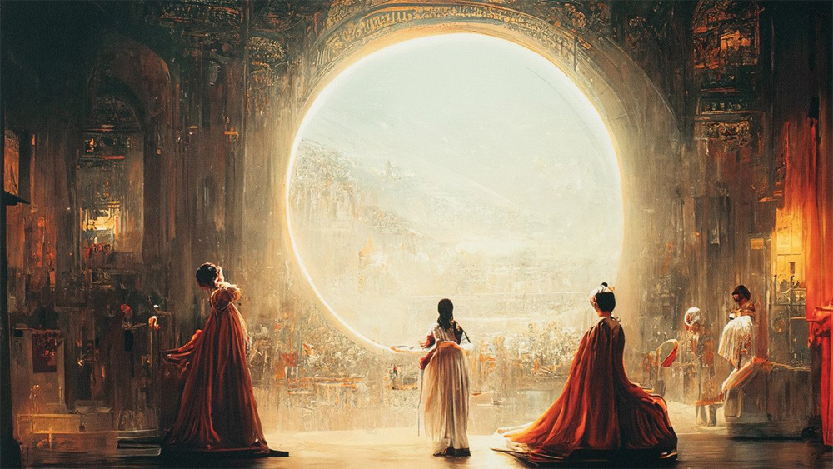
Definition
Has the capability to draw images based on what it learns from its database

Slide 5
Purpose & Benefits
- Produce high quality artwork
- Analyse existing artwork
- Create new artwork
- Develop new and creative ideas
- Apply different art filters

Slide 6

Initial thoughts
Jack
Peter
William

Slide 7

Users
VS
Stakeholders
Customers or individuals utilising product
Individual involved in a project whose interest might be affected because of project execution

Slide 8
Both Stakeholder & user
Artists
The public
- Includes painters,
illustrators, etc.
- The majority
- Most have experience using art related tools like photoshop, etc.
- Most affected by AI technology

Slide 9
Stakeholder
Art exhibition host
Critics
Project sponsors
- Hosts art & cultural exhibitions or activities
- Give their opinions regarding AI
- Who support the creation/maintenance of AI
- Have the authority to accept AI generated artworks
- Journals, articles, etc.
- Investments

Slide 10
User
AI Programmers
- Propose and work on AI technology
- Primary users
- Test AI and fix bugs
- Responsible for explaining scope & limitation to project managers
- Deep learning and other sorts of algorithms

Slide 11

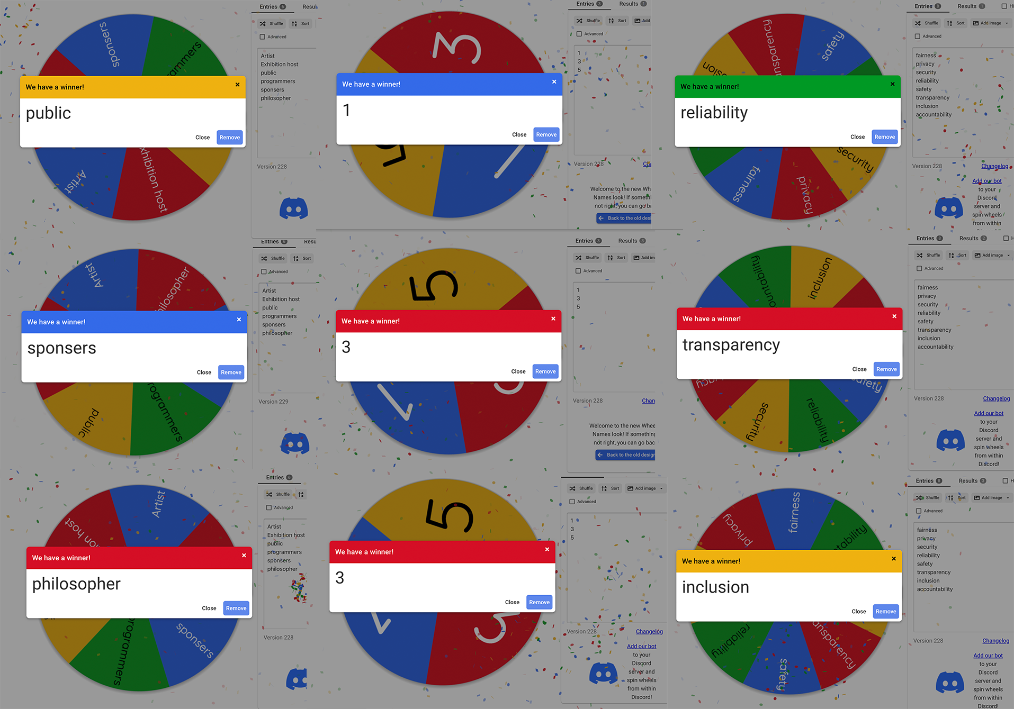
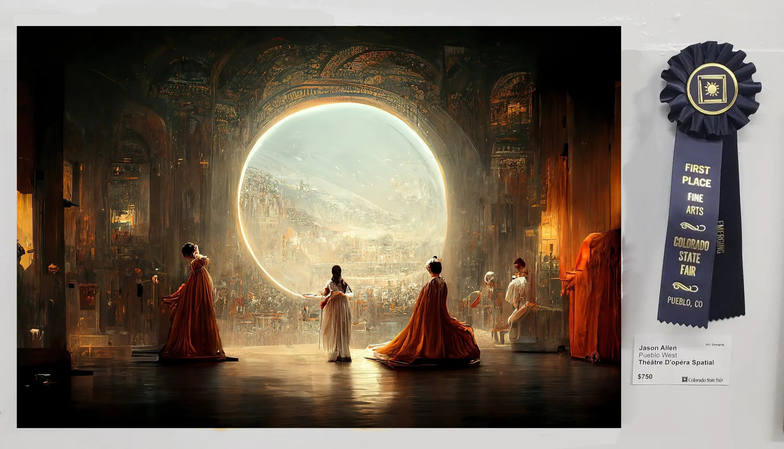
Scenario
Just like the controversy of Jason Allen winning the first place at an art competition by submitting an artwork by an AI, we focus on
A person submitted an artwork generated by a drawing AI to an art competition.
Judgement Call
about Drawing AIs
Drawing AI
Stakeholder
Pass the card
Exhibition Host
Public
Programmers
Project Sponsor
Artist
Philosopher
Principle
Reliability
Transparency
Inclusion
Rating
1
3
3

Slide 12



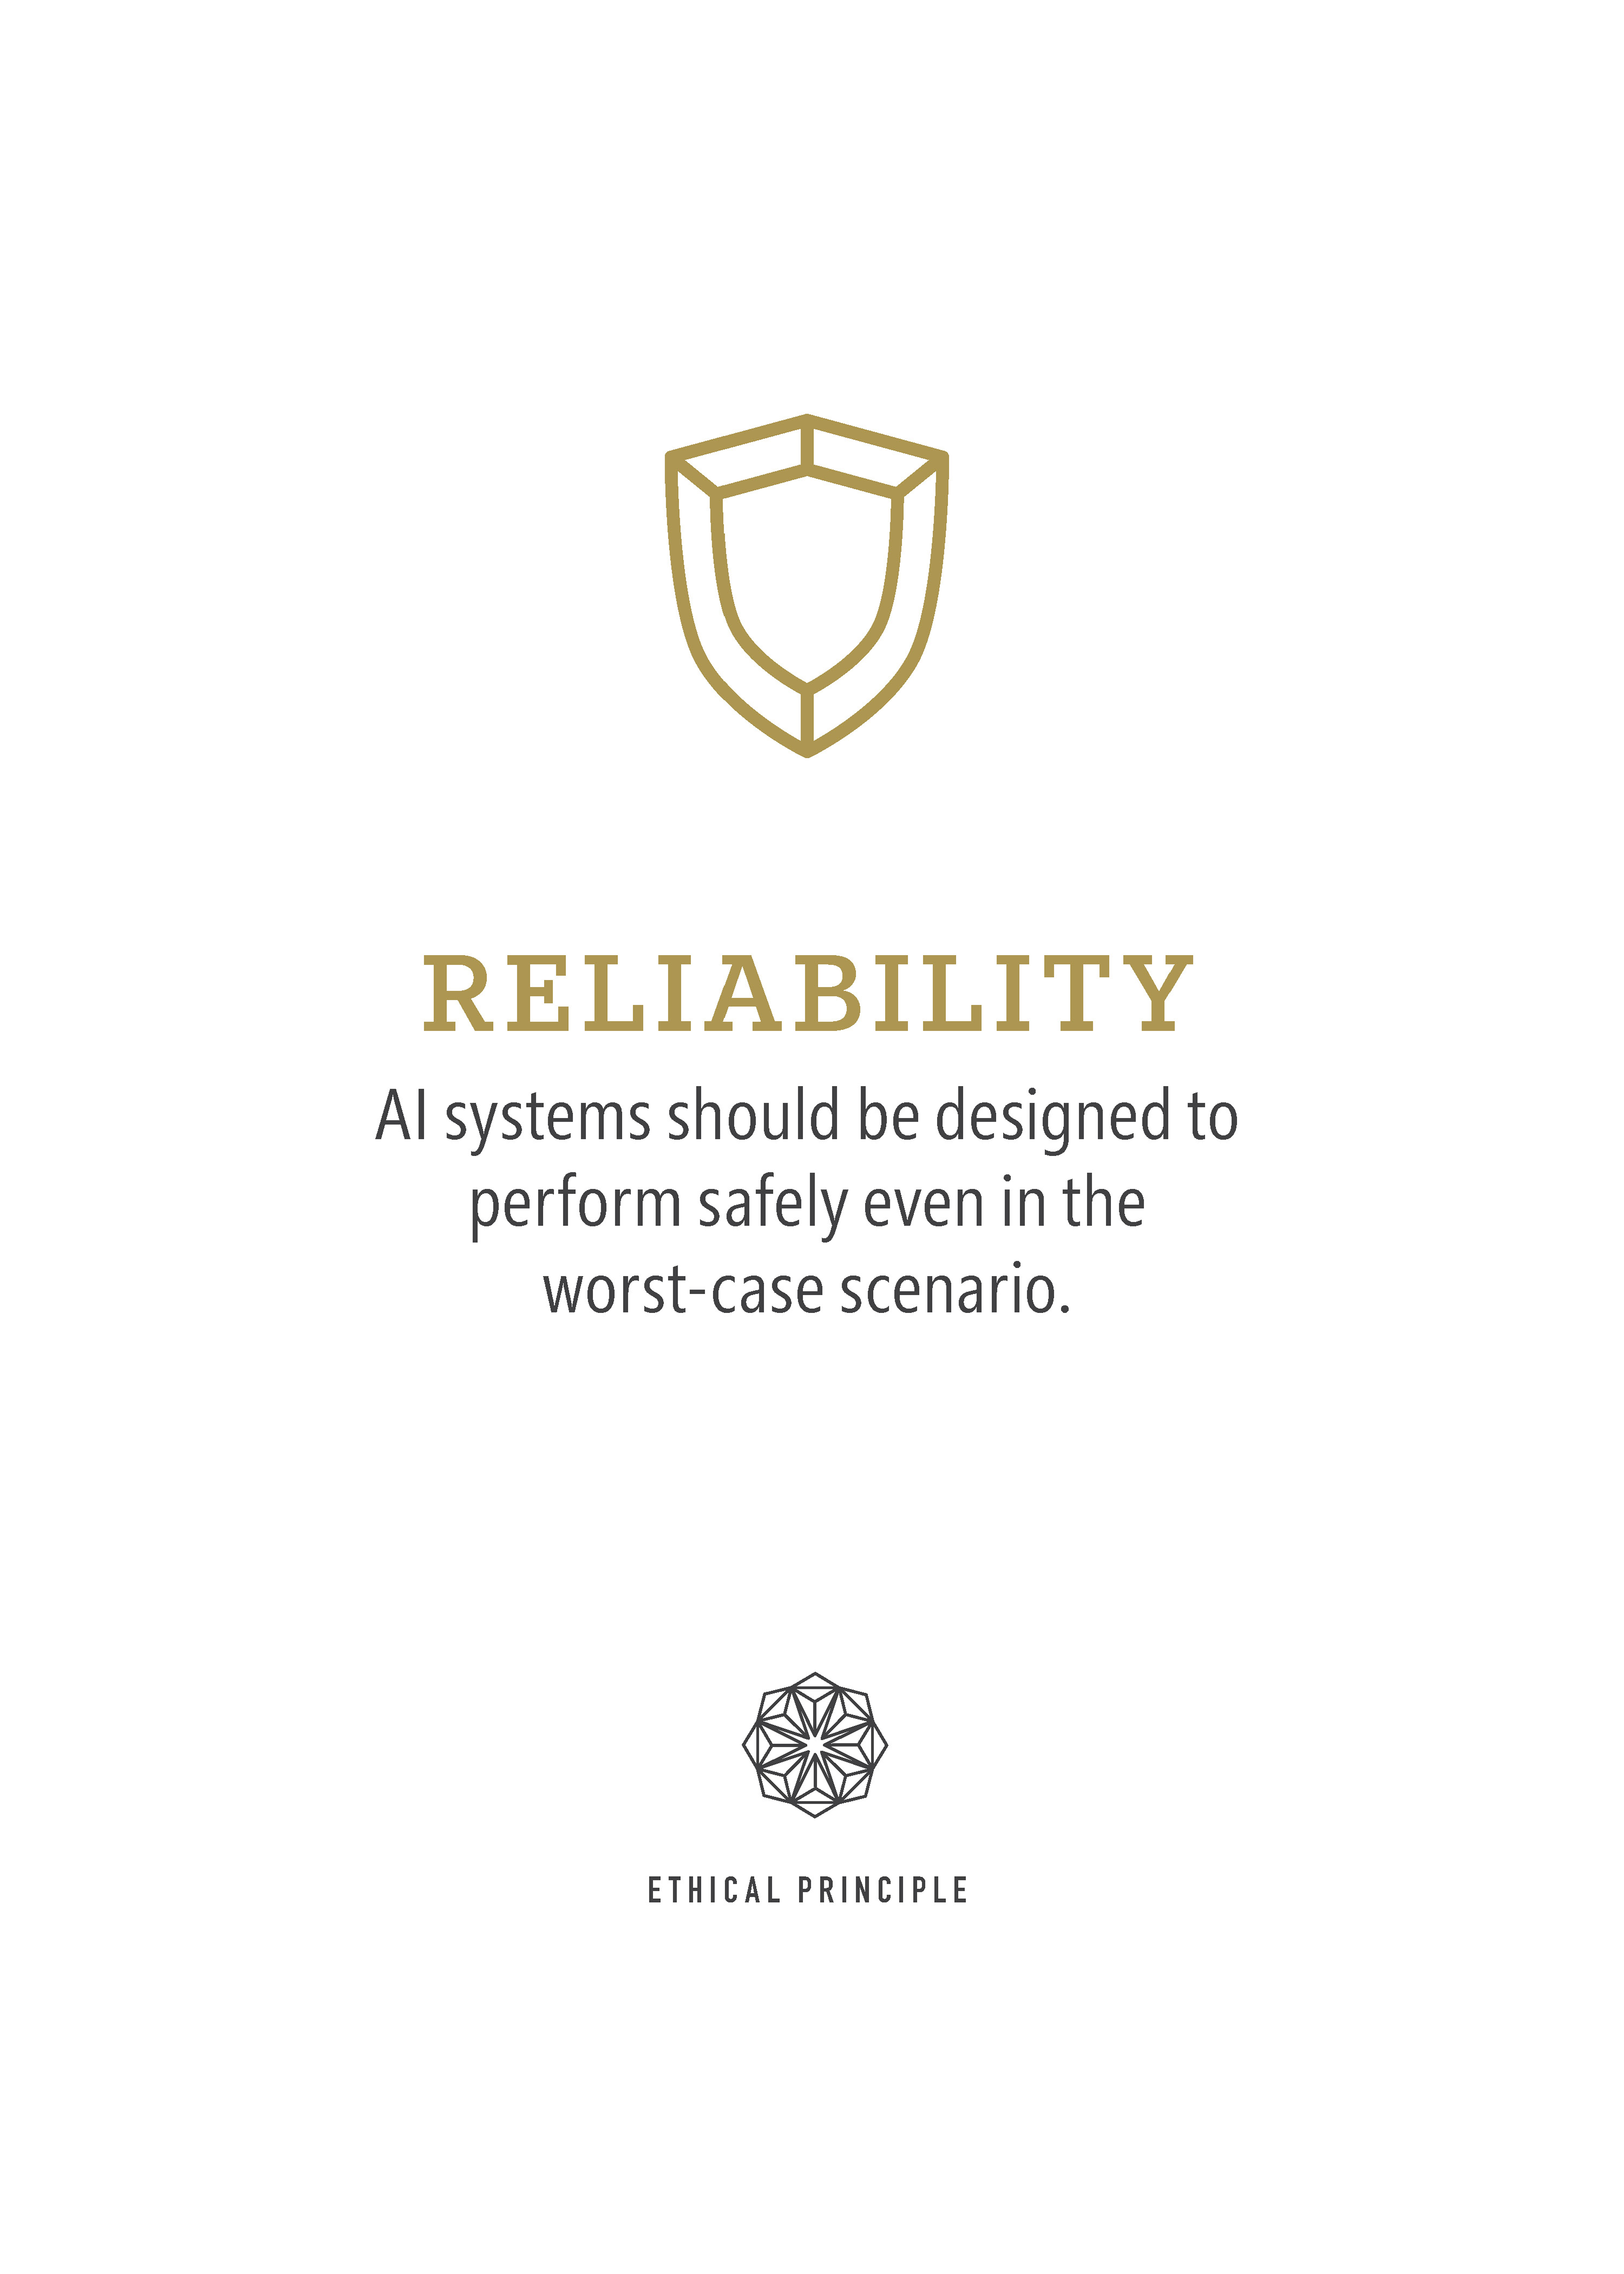

Judgement Call
Scenario
Key word:
Public, Reliability, 1
Review
Just like the controversy of Jason Allen winning the first place at an art competition by submitting an artwork by an AI, we focus on
Doubt whether AI can make correct judgments when face unexpected or malicious user input.
Reliability Problems: The competition is intended for human to compete
A person submitted an artwork generated by a drawing AI to an art competition.
Impact of the technology
Stakeholder
Public
Philosopher
Drawing ai potentially hides the artist's efforts and makes artist's artwork become learning tools.
Project Sponsor
Principle
Reliability
Transparency
Inclusion
Rating
1
3
3

Slide 13



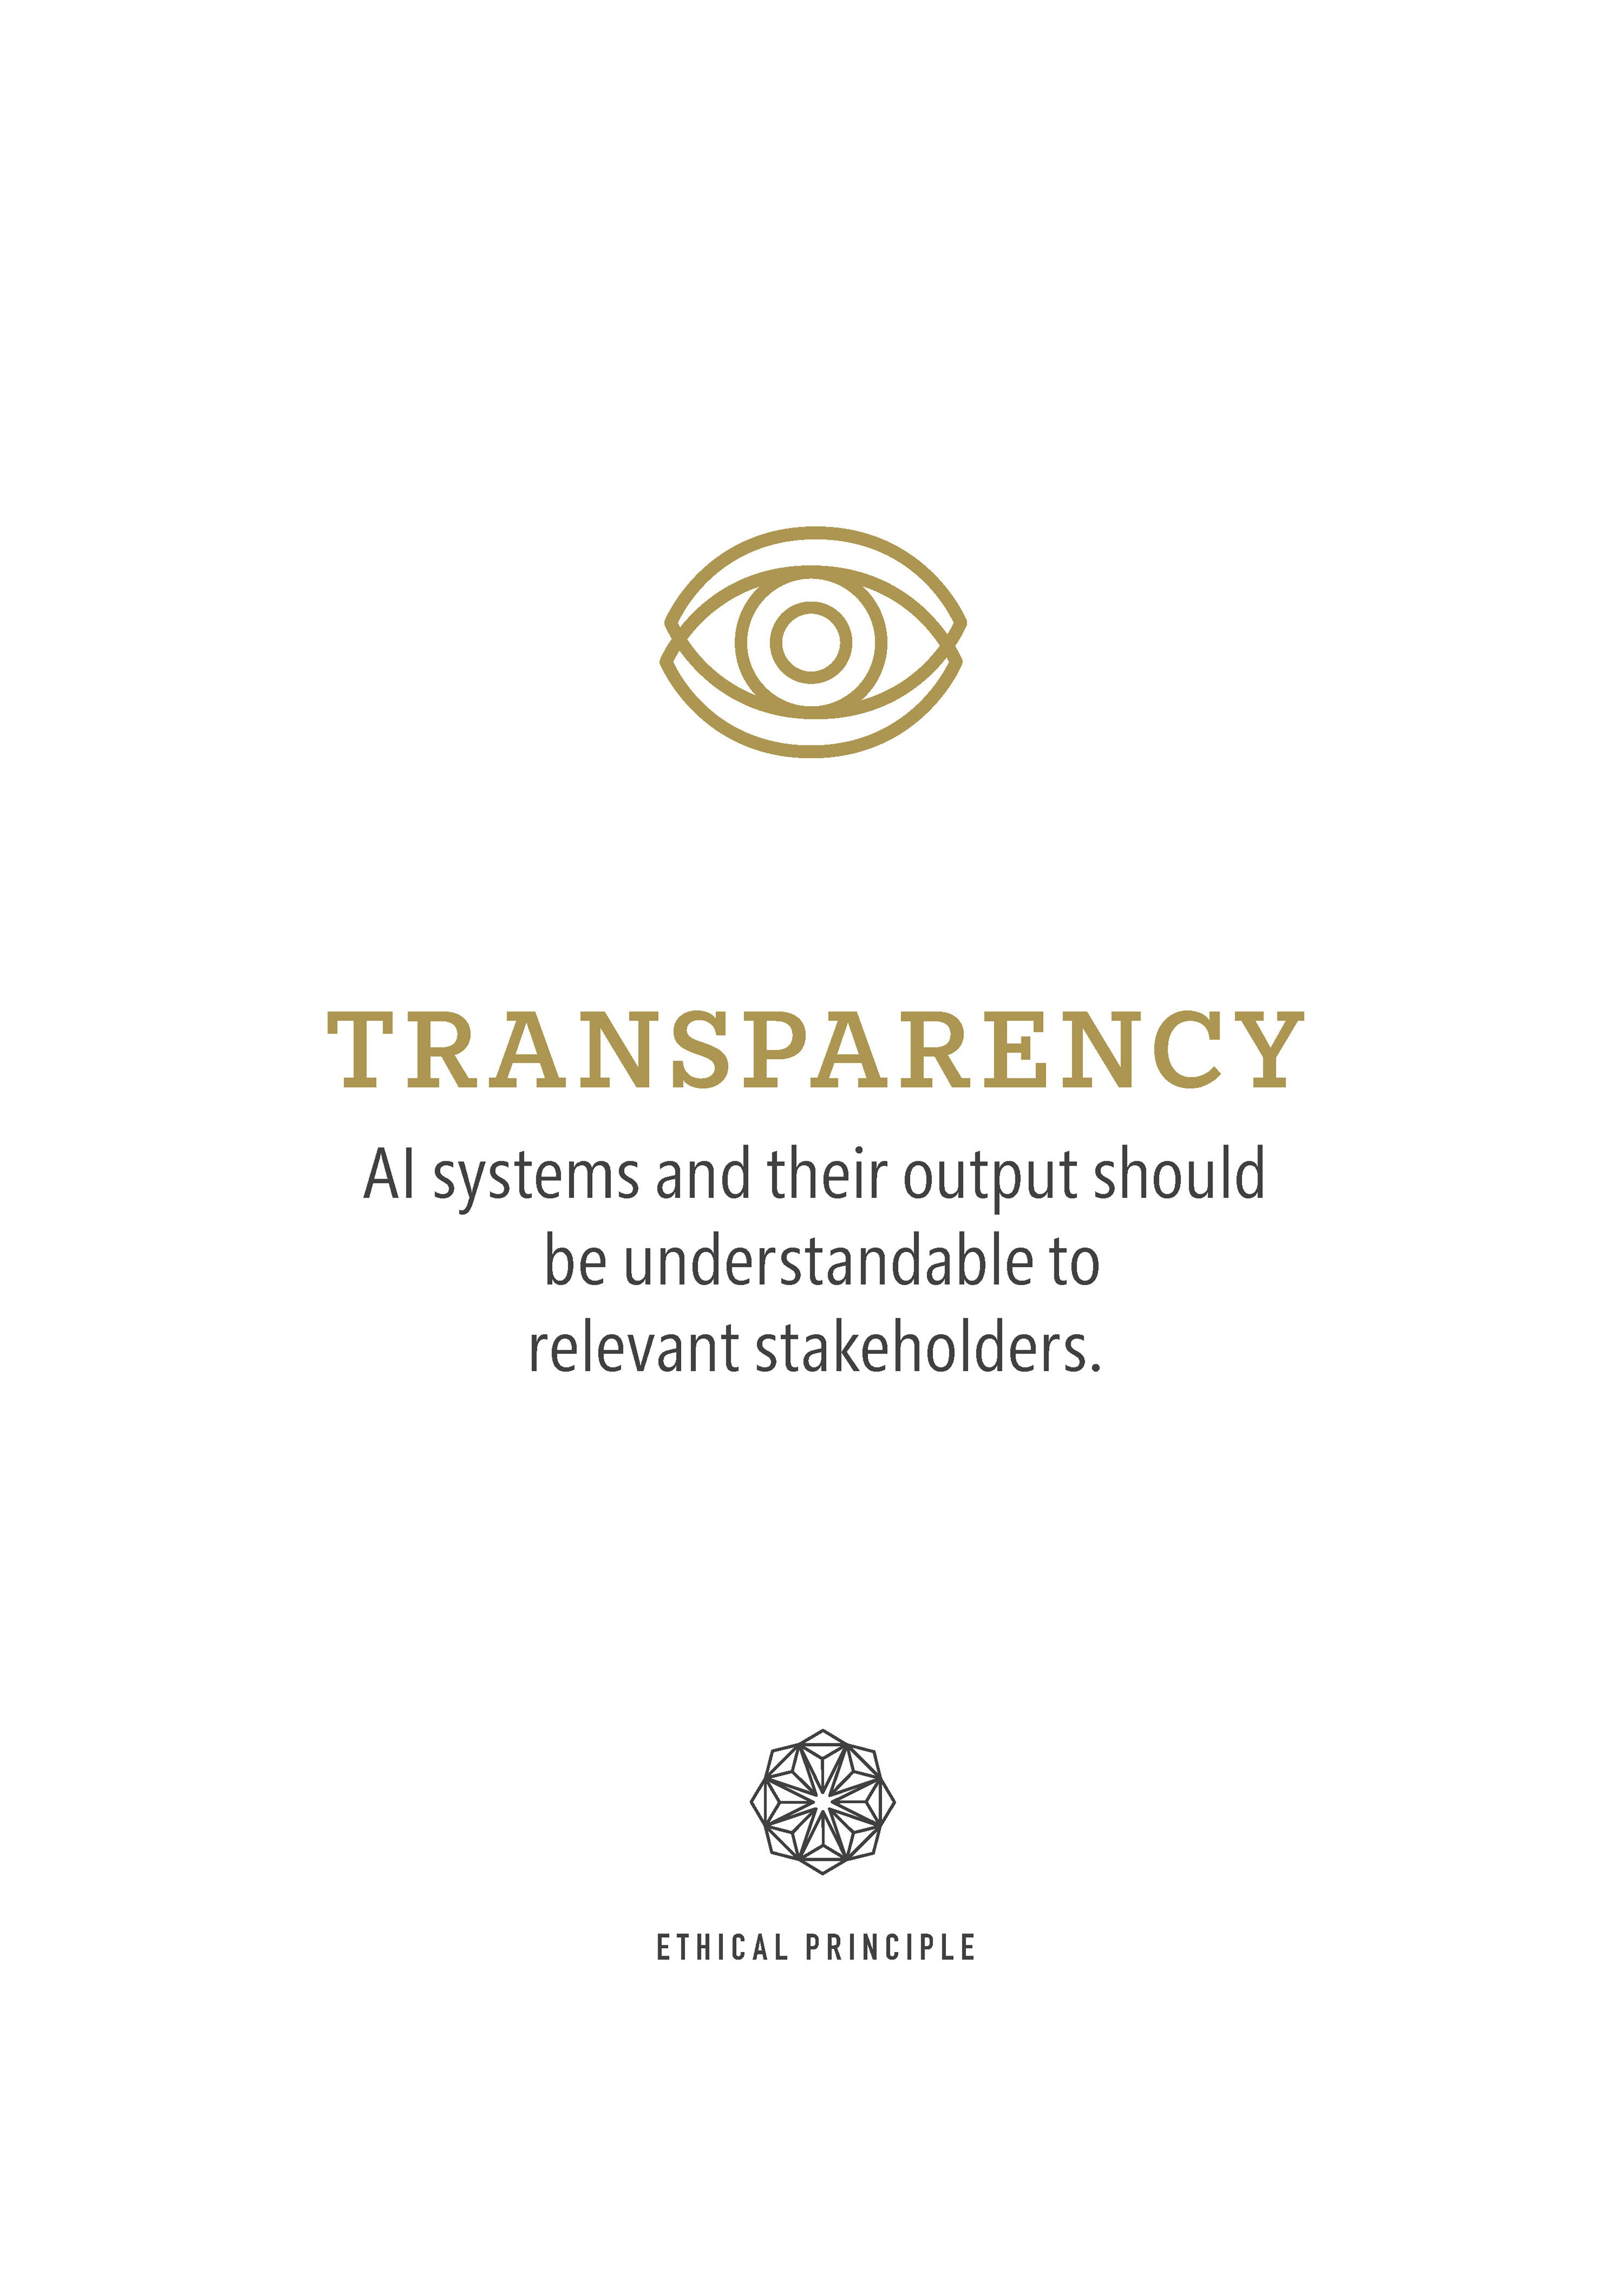

Judgement Call
Scenario
A person submitted an artwork generated by a drawing AI to an art competition.
Key word:
Project Sponsor, Transparency, 3
Review
Public, Reliability, 1
Contradiction
Doubt whether AI can make correct judgments when face unexpected or malicious user input.
Reliability Problems: The competition is intended for human to compete
If the code or model is biased and unfair in terms of gender, age… it will affect the result of machine learning and cause some contradictions in society.
Reason and Solution
Impact of the technology
Unbalanced distribution of real data in the dataset.
Provide more data and remove these biases by utilizing specific strategies in advance
Drawing ai potentially hides the artist's efforts and makes artist's artwork become learning tools.

Slide 14
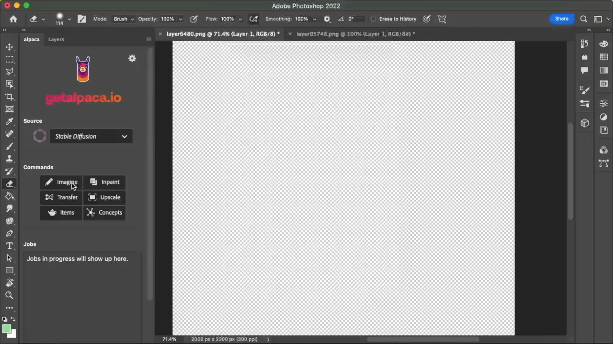
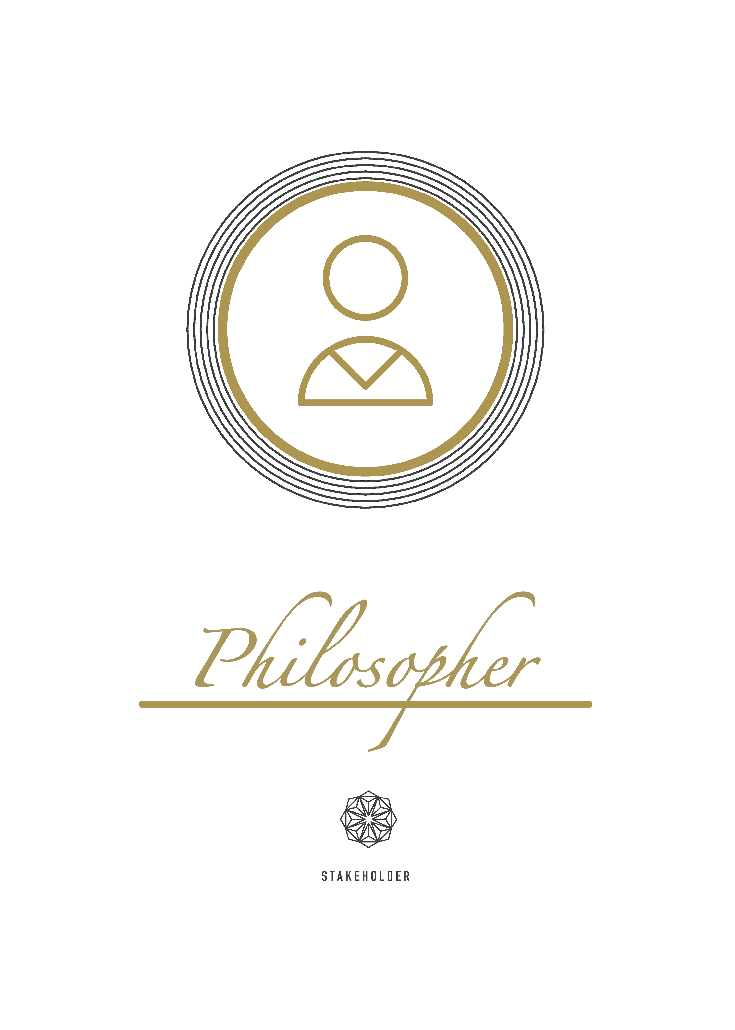
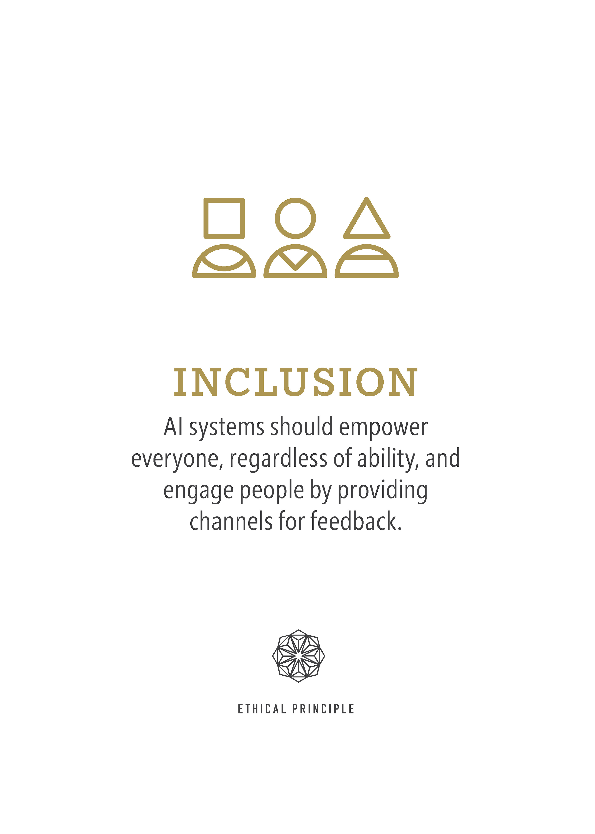

Judgement Call
Scenario
A person submitted an artwork generated by a drawing AI to an art competition.
Key word:
Project Sponsor, Transparency, 3
Philosopher, Inclusion, 3
Contradiction
If the code or model is biased and unfair in terms of gender, age… it will affect the result of machine learning and cause some contradictions in society.
Attribution
Reason and Solution
For a painting co-created by AI and user, how to determine whether the painting is created by AI or user.
Set a modification magnitude to define the attribution problem
Unbalanced distribution of real data in the dataset.
Provide more data and remove these biases by utilizing specific strategies in advance

Slide 15

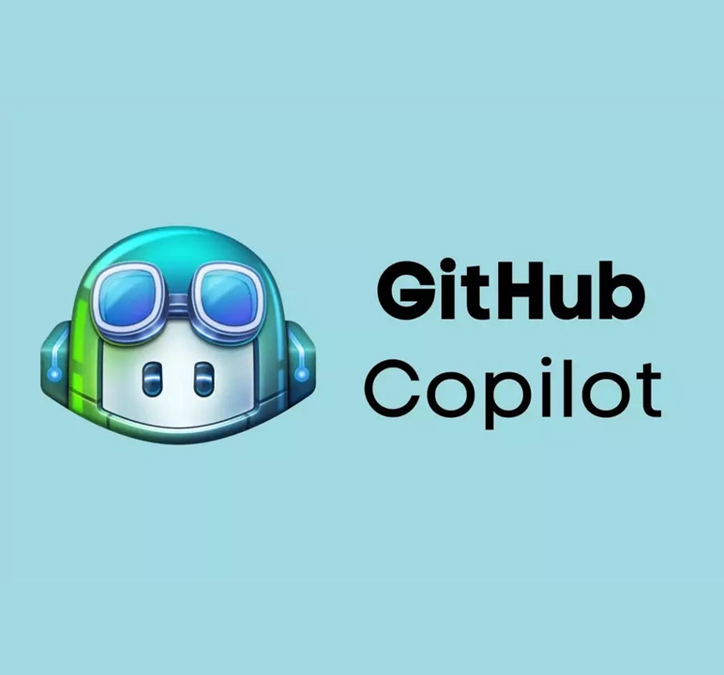
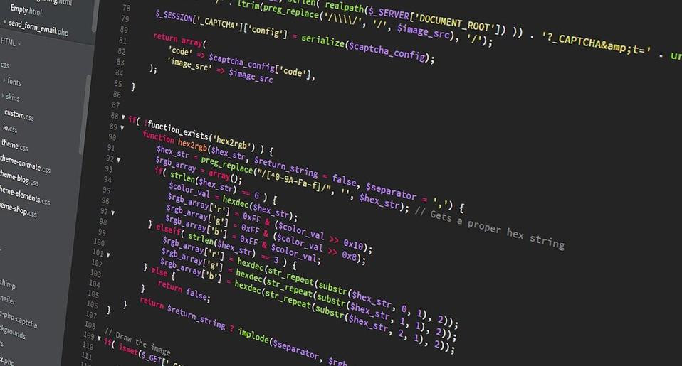

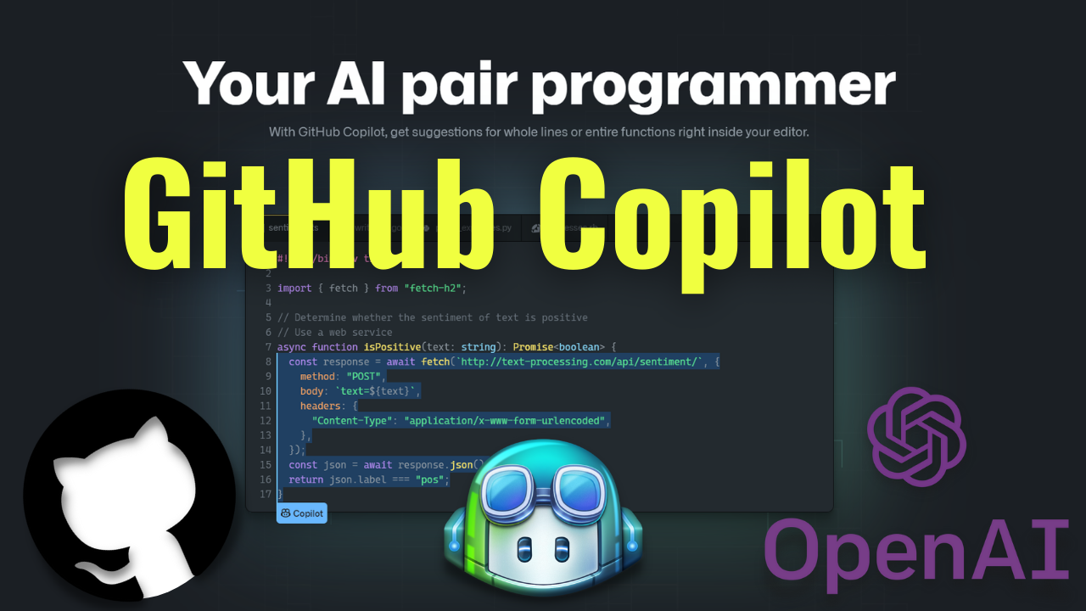
Judgement Call
Scenario
A person submitted an artwork generated by a drawing AI to an art competition.
Key word:
Philosopher, Inclusion, 3
Advantage
Similar Technology – Code Generate AI
Cut development costs while allowing coders to focus on creative, less repetitive tasks
For Users
Greatly assist users to complete the required work.
Risk: For beginning of programmer, excessive reliance on AI to generate code leads to a weak grasp of some programming basics.
For Project Sponsors
Security issues exist.
Pre-screened and check the training code can avoid the problem.
Attribution
For a painting co-created by AI and user, how to determine whether the painting is created by AI or user.
Set a modification magnitude to define the attribution problem

Slide 16
Relationship
Traditional drawing
AI drawing
-The technique theory of traditional drawing art is the theoretical source of AI drawing art
- provides a variety of visual aesthetic choices

Slide 17
Advantages Disadvantages
- enriches artists' creative thinking
- lacks creativity and originality
- further broadens the artists' vision
- issue of copyright infringement

Slide 18
Conclusion
- AI drawing based on computer and traditional painting art forms broadens artists' creative thinking
- Recognize the drawbacks brought by the era of artificial intelligence to the development of art
- regard digital technology as a tool and means for artistic creation and not rely entirely on science and technology.

Slide 19
Recommendation
- change the source of the dataset for training the model etc. pinterest
- Art competition:Divide into human only & AI only

